Slide 1

AI Powered Resume Shortlisting Tool
Streamline your hiring process with AI-powered resume shortlisting

Slide 2

The Problem
→ Manual shortlisting is time-consuming and prone
to unconscious bias.
→ Existing tools utilize mainly keyword based matching and semantic matching which can fail to capture nuances and depths.

Slide 3
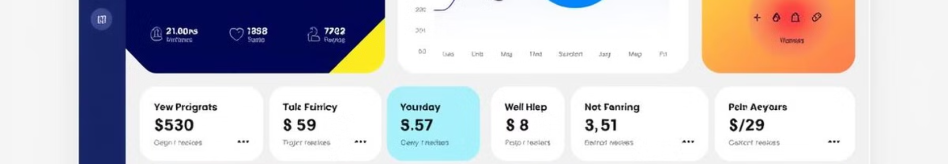
Our Solution
Resume Parser
Portfolio and Trajectory Analysis
Extracts key data from resumes
Evaluates candidate's GitHub repositories
Assesses career and progression patterns
Compatibility Scoring
Candidate-Job Match
Bipartite graph representation with edges representing compatibility scores optimized by GNN
leveraging quantum algorithms to solve combinatorial optimization problem of candidate job matching efficiently, as the input becomes larger

Slide 4
Workflow Architecture
Resume Parser
1
Structured data
extraction
Portfolio Analysis
2
Code quality,
Trajectory Analysis
activity, skills
3
Role transitions,
industry shifts
Compatibility Scoring
4
GNN-based
Quantum Module
match scores
5
Efficient batch
candidate-job matching

Slide 5

Key Advantages
1
Automation & Scalability
2
Modular Design
Easy integration
Streamline large-scale
with existing systems
resume processing
3
Touch of AI
4
Quantum Optimization
capture nuances better
Handling job assignment for large datasets

Slide 6
Results Snaps

Slide 7
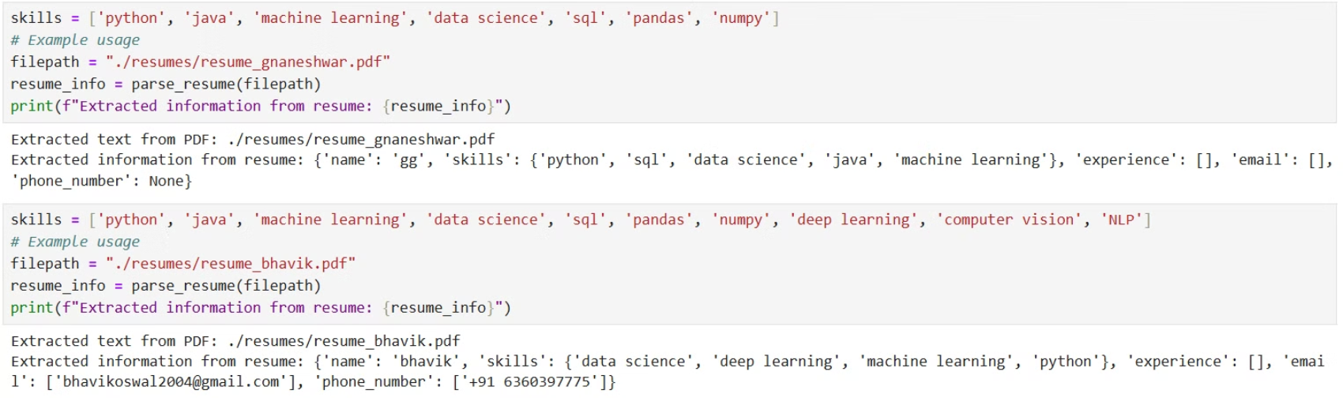
Parser:

Slide 8
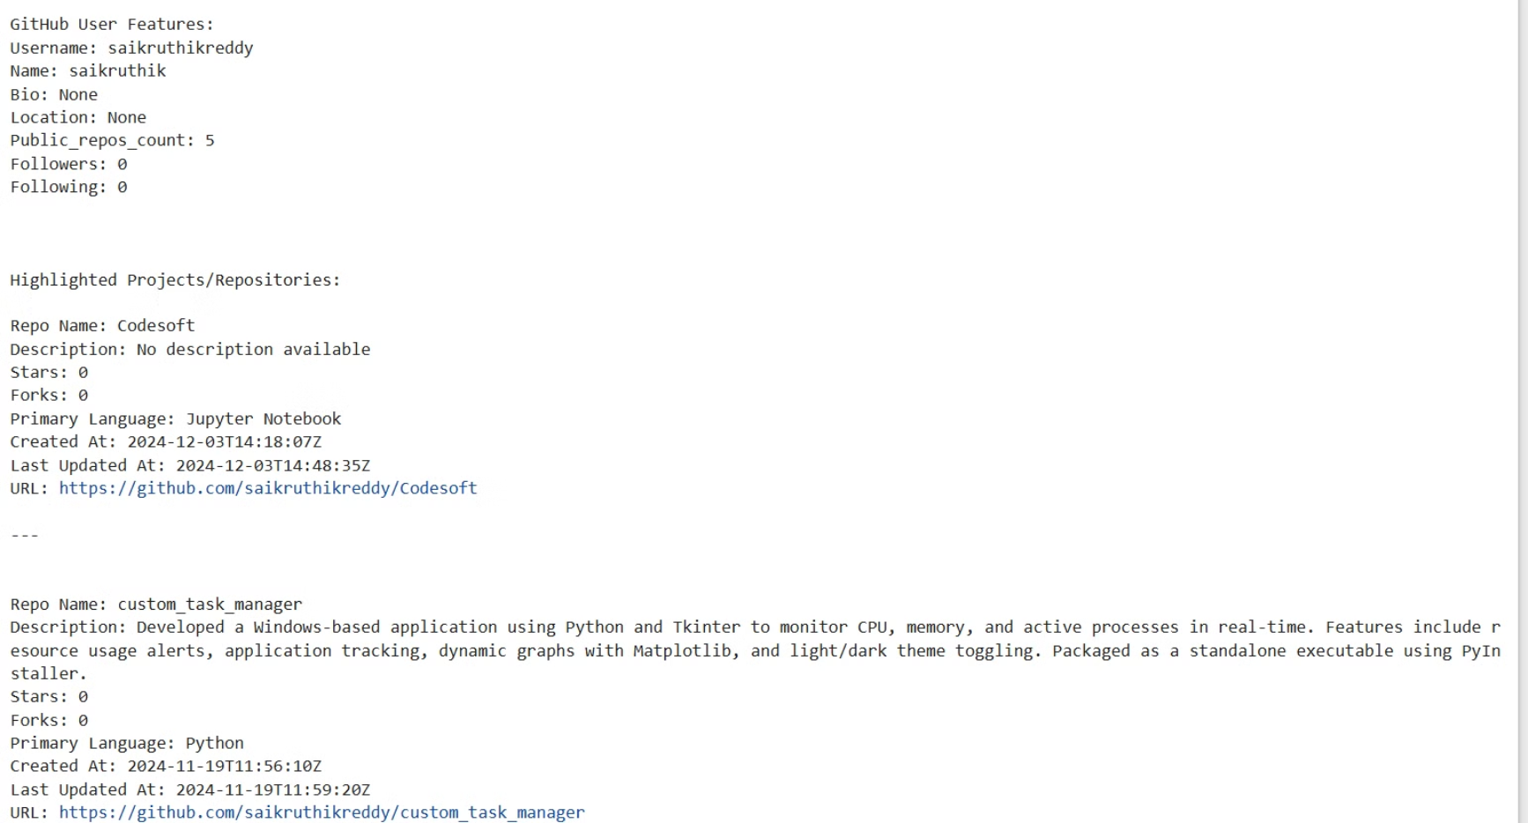
Portfolio Analysis:

Slide 9
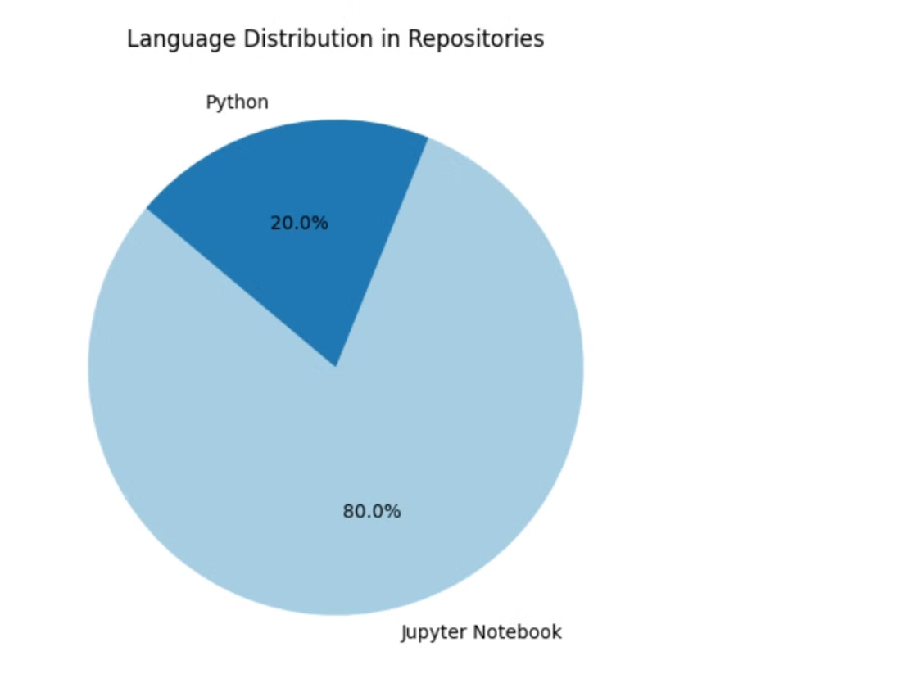
Portfolio Analysis:

Slide 10
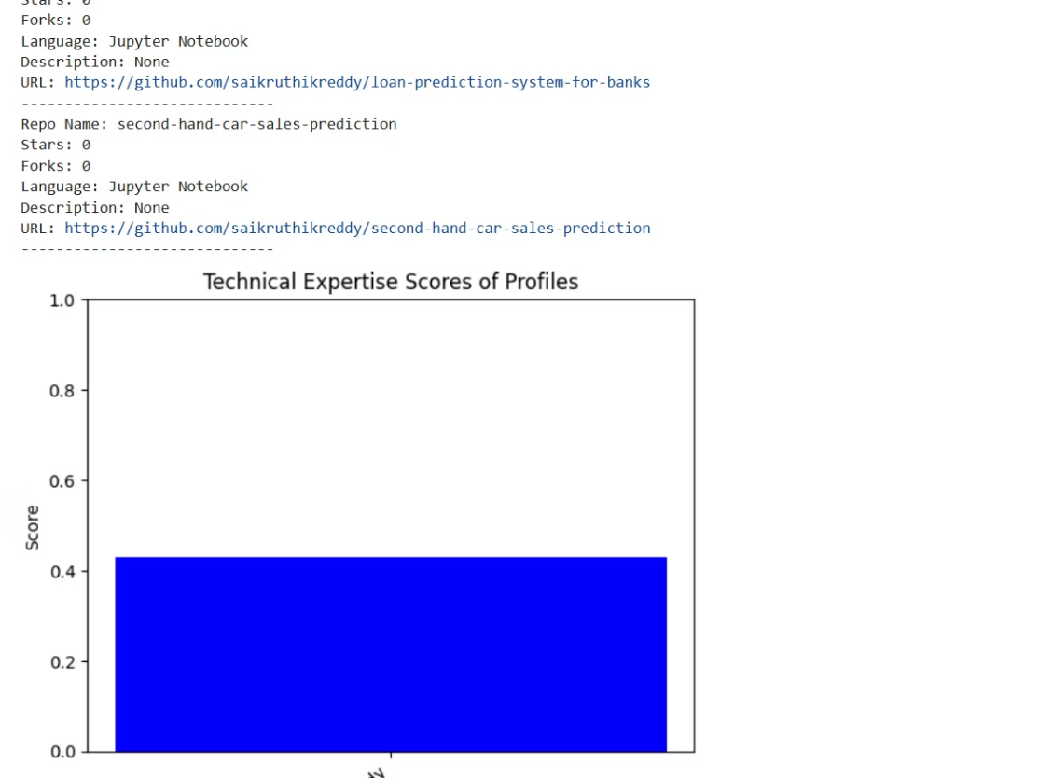
Portfolio Analysis:

Slide 11
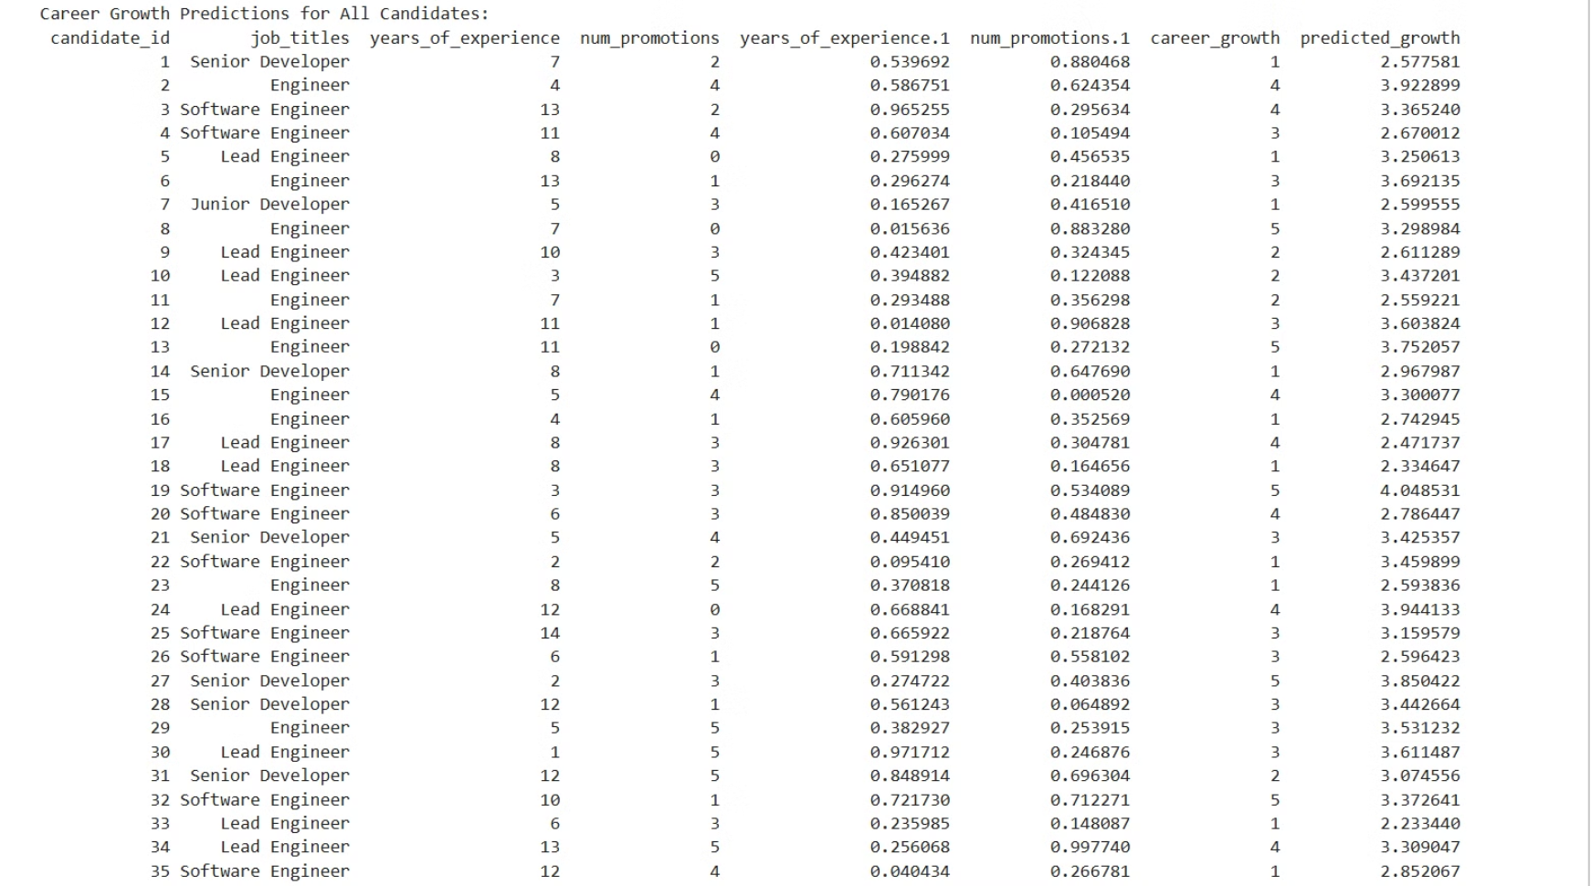
Career Trajectory:

Slide 12
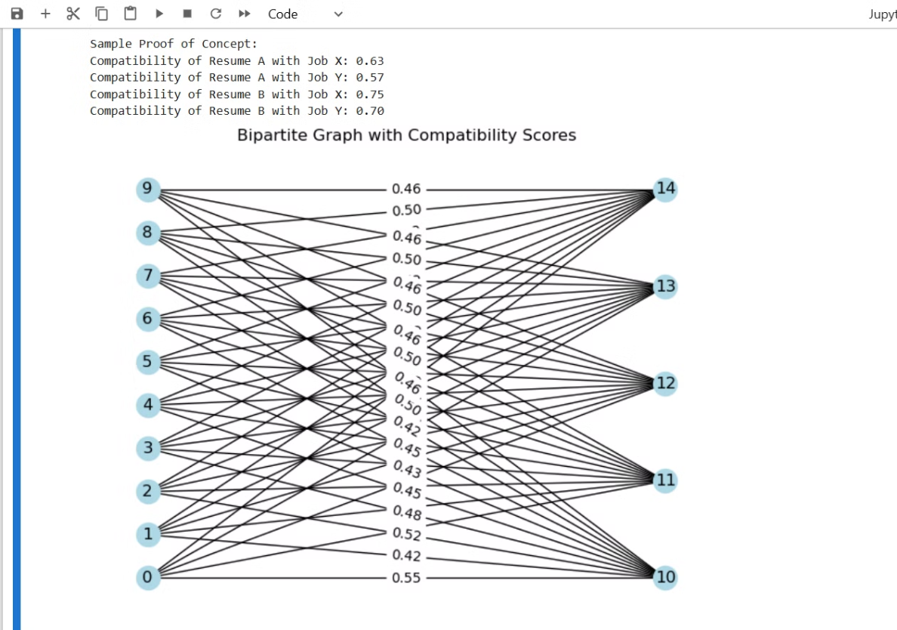
GNN Module:

Slide 13
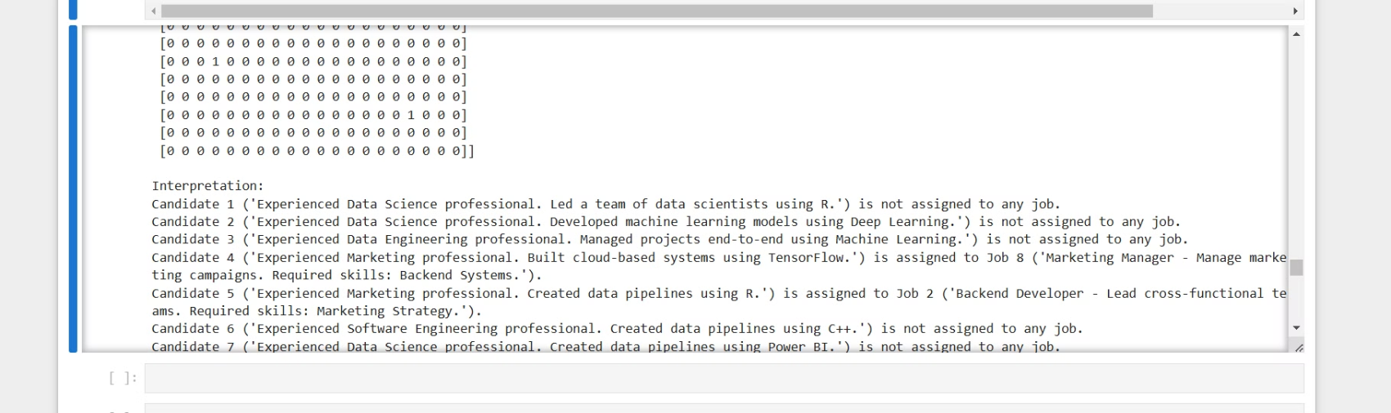
Quantum Module:

Slide 14
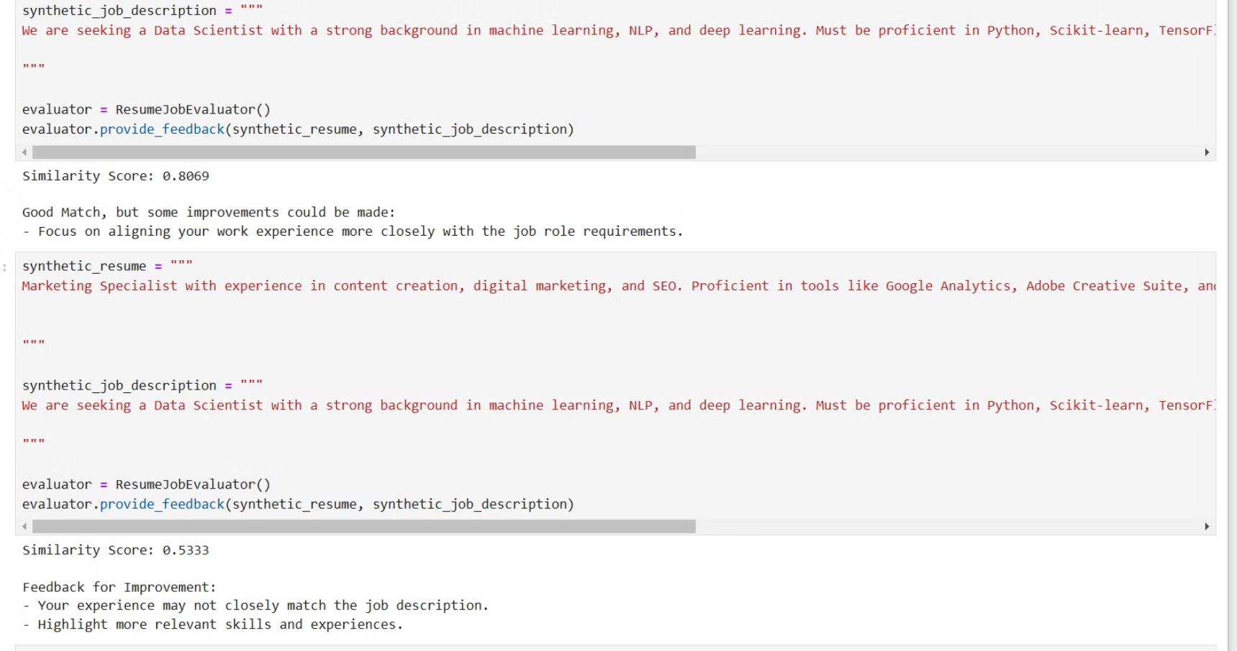
Feedback:

Slide 15



Future Potential
Expanded Portfolio Analysis
Include LinkedIn profiles
1
and Kaggle projects
highly optimized and customized GNN
2
capture nuances and custom requirements with great depth
Predictive Analytics
3
Forecast candidate
performance and fit

Slide 16

Let's Talk
We're ready to discuss how this tool can transform your hiring process

